Slide 1
Electricity & Magnetism

Slide 2
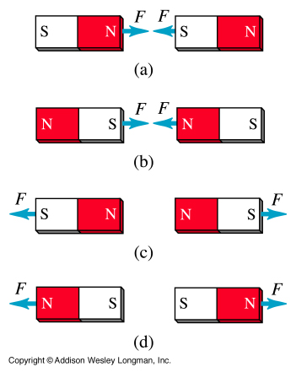
Magnets
A piece of ferromagnetic material that attracts object made out of iron.
It has north pole and south pole
Like poles of magnet repel
Unlike poles of magnet attract

Slide 3
For Every North, There is a South
Every magnet has at least one north pole and one south pole. By convention, we say that the magnetic field lines leave the North end of a magnet and enter the South end of a magnet.
If you take a bar magnet and break it into two pieces, each piece will again have a North pole and a South pole. If you take one of those pieces and break it into two, each of the smaller pieces will have a North pole and a South pole. No matter how small the pieces of the magnet become, each piece will have a North pole and a South pole.
S
N
S
N
S
N

Slide 4
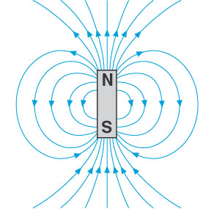
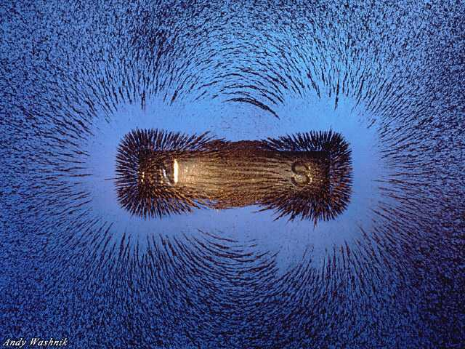
Magnetic Field
A bar magnet has a magnetic field around it. This field is 3D in nature and often represented by lines LEAVING north and ENTERING south

Slide 5
Magnetic Field
Field lines converge where the magnetic force is strong, and spread out where it is weak
The density of field lines indicates the strength of the field
Weak Field
Strong Field

Slide 6
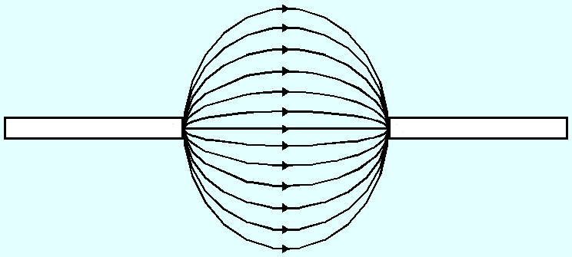

Field Lines between Magnet
Unlike poles
Attraction
N
S
Leave N and enter S
N
N
Repulsion
Like poles

Slide 7
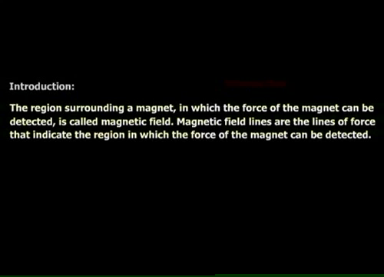
Field Lines between Magnet

Slide 8
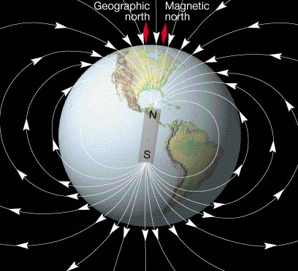
Earth’s Magnetic field
When you attach a magnet to string and freely suspend it, it would align itself so that the north pole of the magnet points towards the geographical north pole of earth and the south pole of the magnet would be pointing towards the geographical south pole of earth

Slide 9
Magnetic field in current carrying conductor
Magnetism is produced not only by magnets but also by electric currents.
Moving charge induce a magnetic field around it
The direction of magnetic field can be deduce using RIGHT HAND GRIP RULE

Slide 10
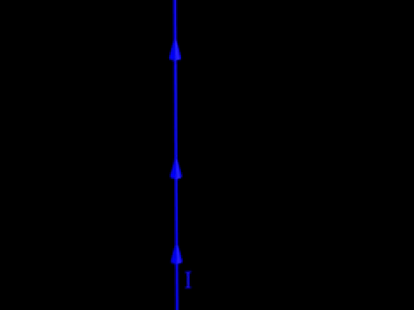
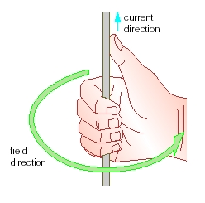
Magnetic field in a current carrying conductor

Slide 11

Magnetic field in current carrying conductor.
current: down into page
current: up out of paper
wire
(end view)
×
•
Symbols for current direction:

Slide 12
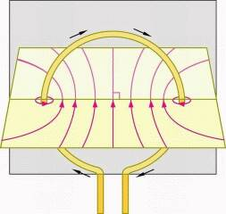
Magnetic field in a single coil
At the centre:
circular coil
magnetic field lines are straight &
at right angles to the plane.
Outside the coil:
magnetic field lines run in loops.
current direction

Slide 13
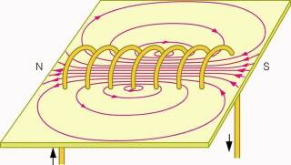
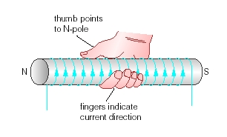
Magnetic field in solenoids
Solenoid: A long coil with many turns of wire
I
I

Slide 14
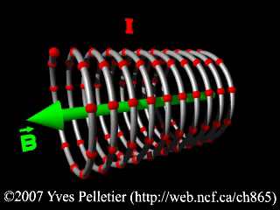
Magnetic field in solenoids
Solenoid: A long coil with many turns of wire
S
N
I

Slide 15
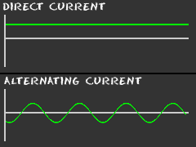
Alternating current and direct current
AC Voltage (current) is a voltage (current) that changes in magnitude and direction with respect to time.
DC voltage (current) is constant with respect to time.

Slide 16
Alternating current
V
+340
V_{p}
V_{pp}
10
20
Time(ms)
0
Period , T = 20ms
Frequency = 50Hz
V_{peak} = 340V
V_{peak to peak} = 680V
-340

Slide 17
RMS voltage (current)
RMS voltage gives the equivalent dc voltage that will supply the same amount of average power as AC voltage
Eg: AC Voltage = 340V , Vrms = 240V
340 V AC supply provide the same amount of power as 240 V DC supply would

Slide 18
Ohm’s Law
Potential Difference across a resistance, V is directly proportional to the current flowing through the element , I.
V
V = IR
I

Slide 19
Electric Circuit
Resistors Arrangement

Slide 20

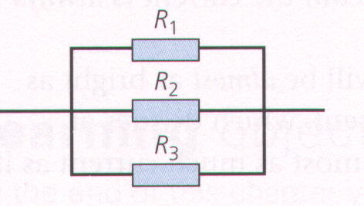
Resistors and Resistance
Resistors can be connected either in:
Series
Parallel

Slide 21
Resistors in Series
The total resistance (effective resistance or resultant resistance) is equal to the sum of the individual resistance.
R_{total} = R₁ + R₂ + R₃

Slide 22
Resistors in Parallel
The reciprocal of the total resistance (effective resistance or resultant resistance) is equal to the sum of the reciprocal of individual resistance.

Slide 23
Resistors in Parallel
If two resistors of resistance R₁ and R₂ are connected in parallel, the total/effective resistance is smaller than the R₁ & R₂.
I₁
R₁
I₂
R₂

Slide 24
Summary (Resistance)
Resistors in series
The combined resistance, R, of resistors in series is found by adding up all the individual resistance
R = R₁ + R₂ + R₃ +…..
Resistors in parallel
The combined resistance, R, of resistors connected in parallel is less than that of any one of the resistors

Slide 25
Current in Series Circuits
A series circuit has only one path in which charge can flow.
The current is same everywhere. ( I = I₁ = I₂ = I₃ )
Battery
Switch
I
I₁
I₂
I₃
R
R
R

Slide 26
Current in Parallel Circuit
A parallel circuit has more than one path for the current to flow.
Switch
I₁
I
R₁
I
I₂
R₂
I₃
R₃
The main current is equal to the sum of the sub-currents. ( I = I₁+I₂+I₃ )

Slide 27
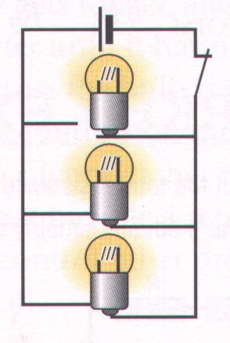
Current in Parallel Circuit
What will happen if one of the lamp is being removed?
Answer:
Apart from the lamp that was being removed, the rest of the lamp will continue to light up.

Slide 28
Short Circuit
A B
In the fig. shown, AB is a copper wire which connects two point A and B in the circuit.
Since the copper wire has very little resistance, therefore a large amount of current will flow through it.
The lamp then go off. (Why?)
Therefore we say this circuit is now a short circuit.
Notes:
28

Slide 29
P.D. in Series Circuits
V₁
Switch
I
V₂
V₃
V₄
L₁
L₂
L₃
V₁= V₂ + V₃ + V₄

Slide 30
P.D. in Series Circuits
V_{T}
Switch
I
V₁
V₂
V₃
R₁
R₂
R₃

Slide 31
P.D. in Series Circuits
The sum of the p.d across individual components in a series circuit, is equal to the p.d across the whole circuit.
The component with the largest resistance has the highest potential difference across it (i.e. V = I x R)

Slide 32
P.D. in Parallel Circuit
V₁
Switch
I
V₂
V₁ = V₂ = V₃
I₁
V₃
I₂

Slide 33

P.D. in Parallel Circuit
V₁
Switch
I
V₂
I₁
V₃
I₂

Slide 34
Summary
The p.d. across all the components in a parallel circuit is the same.
The sum of the p.d. across individual components in a series circuit, is equal to the p.d. across the whole circuit.

Slide 35
Series & Parallel Circuits
Series Circuit
A series circuit has only one path for the current to flow.
I = I₁ = I₂ = I₃
The sum of the p.d. across individual components in a series circuit, is equal to the p.d. across the whole circuit.
Parallel Circuit
A parallel circuit has more than one path for the current to flow.
I = I₁+ I₂ + I₃
The p.d. across all the components in a parallel circuit is the same.

